Slide 1
Multi-Modal Large Language Models for the Improvement of Object Detection Models
Neal Gross

Slide 2
Some current problems with object detection models
Object Detection Models are not perfect and have various ways of failing
False Positives – incorrect classification and or detection of objects
False Negatives – a failure in identify and localizing an object of interest
Failures can occur more frequently when there is a change in domain or adversarial attacks or noise affecting the underlying input.
Conventional object detection models are limited in their ability to explain how they came to their results.
It is not easy to determine why a model may have missed an object or detected an incorrect object.
Object Detection is limited in providing contextual information of the scene and interactions between objects

Slide 3
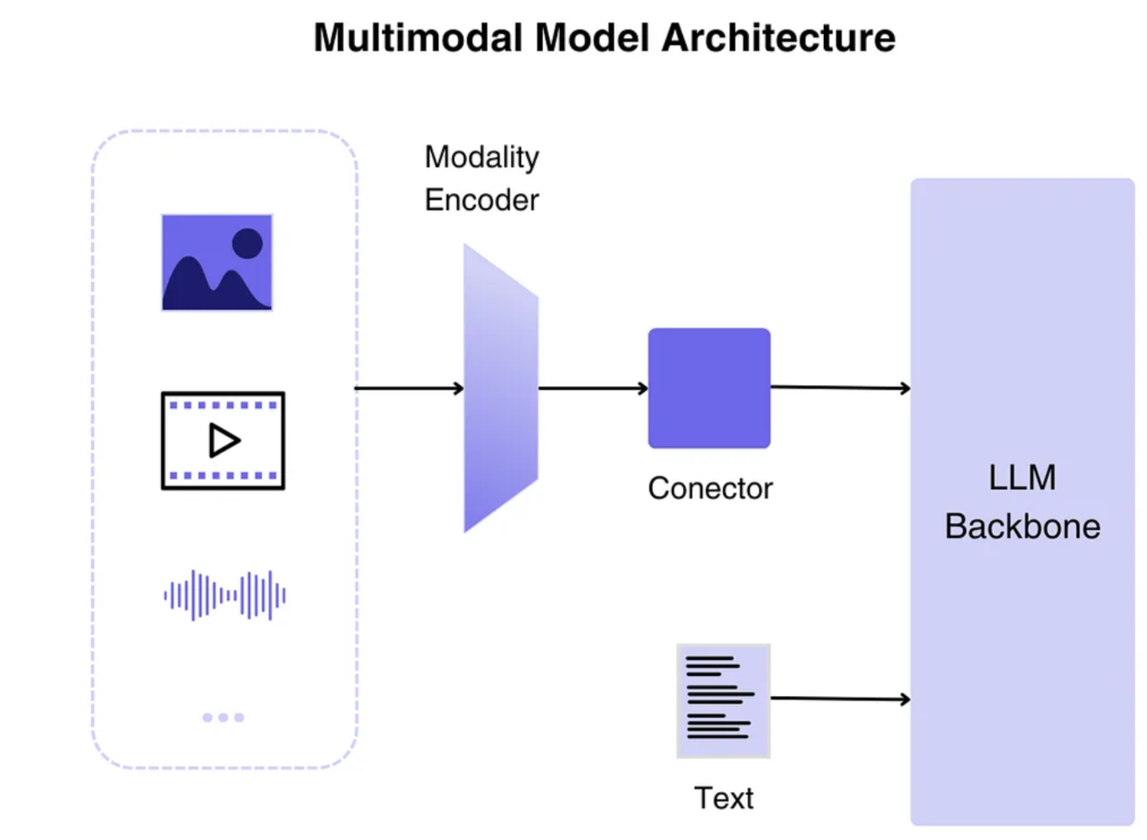
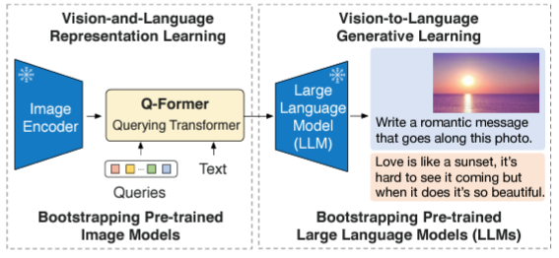
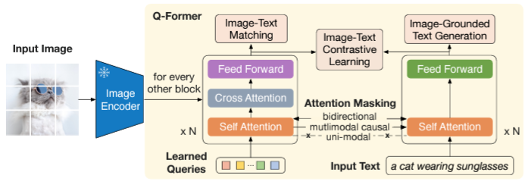
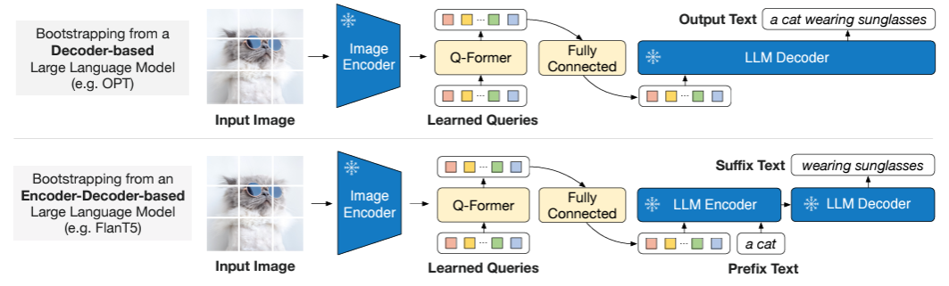
Multi-Modal Large Language Models (MMLLMs)
MMLLM an advanced AI system that can process and understand different types of data, such as text, images, maps audio, video and other types of inputs.
Below is a diagram of BLIP2’s architecture

Slide 4
Goals
We want to understand ways in which MMLLMs could be leveraged to address the issues of conventional object detection models. Can they be used to:
Improve object detection
Reduce failures
Provide robustness to attacks or noise in the input
Improve object detection explainability
Provide contextual information

Slide 5
Initial Exploration to Scope Work
The goal here is to provide a bit initial assessment to which areas may be valuable and achievable in the overall project effort.
MMLLM ability to describe and identify objects in a scene
MMLLM ability to identify objects extracted by a conventional object detector
MMLLM susceptibility to adversarial attacks
For 1, 2, and 3 how do different prompts effect results
Given the above are there ways to enhance conventional object detection models with MMLLMs
Do MMLLMs out of the box provide reasonable contextual information on a new domain?

Slide 6
Exploration so far
Retrieved and chipped a dataset to begin experimentation
Dataset: iSAID (DOTA) with 512x512 chips
Got COTS models
Object Detector: YOLOv8 trained on chipped dataset
MMLLM: BLIP2 (no retraining)
trained with imagenet and imagnet 21k
Some evidence suggesting trained with google satellite images (referenced in prompts)
Started collecting data
Experimentation with different prompts
A photo of, a picture of, the image quality is, there are
BLIP2 prompt results on chips
BLIP2 prompt results on detection annotations
BLIP2 prompt results on blur, rotation, dropping pixels
Investigating MMLLM use in papers

Slide 7
1. MMLLM ability to describe and identify objects in a scene
BLIP2 is much slower than real time object detectors
It is able to generically describe a scene, identifying some key objects and context of the scene.
It is not good at counting (at least out of the box)
It is difficult to get BLIP2 to focus on specific objects
The prompt needs to be specific to extract detailed information
It’s not very good at identifying image quality

Slide 8
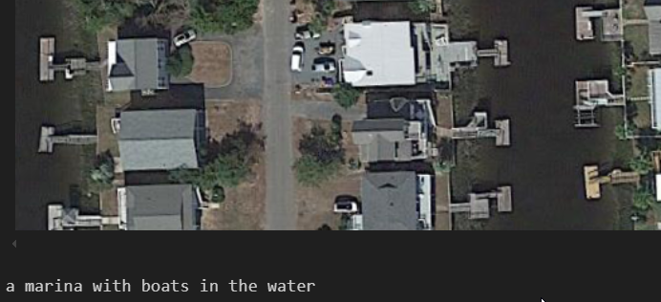
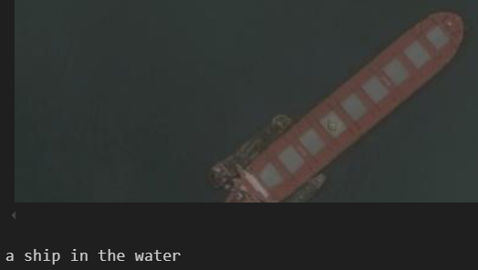
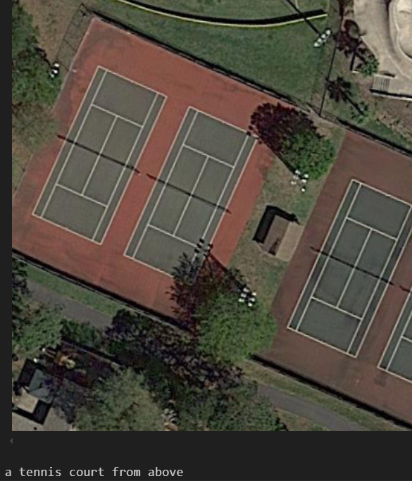
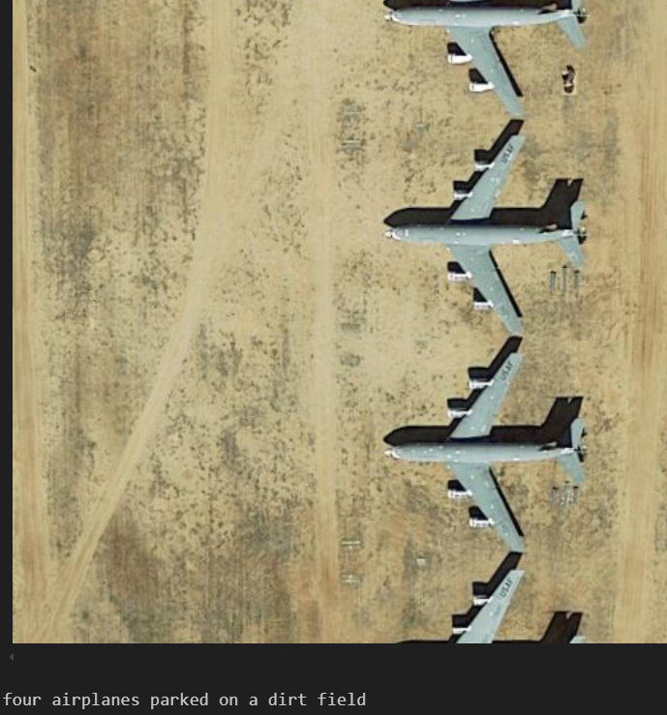
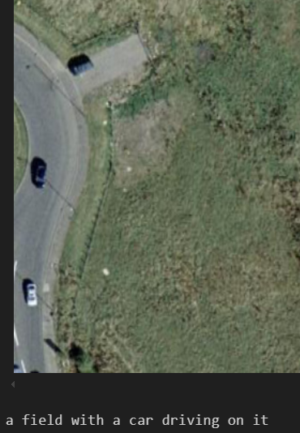
1. MMLLM ability to describe and identify objects in a scene
Prompt: “A photo of”
Rarely incorrect description, but may not be desired description
Lacks specificity of objects or events of interest

Slide 9
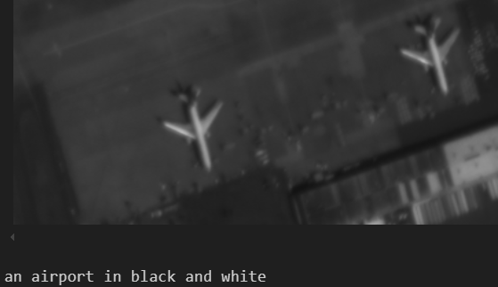
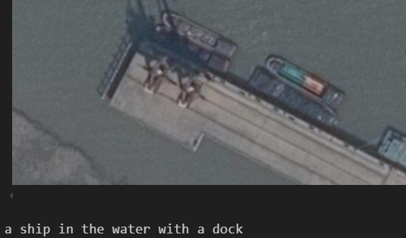
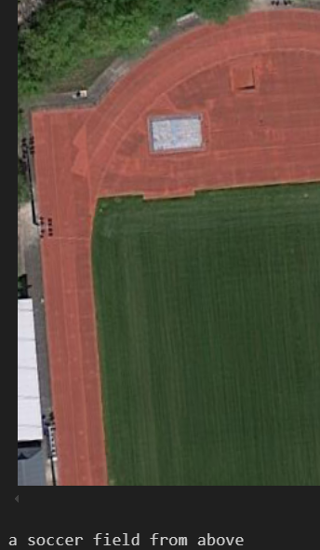
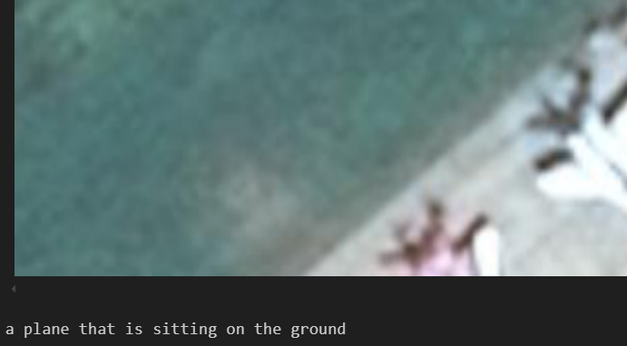
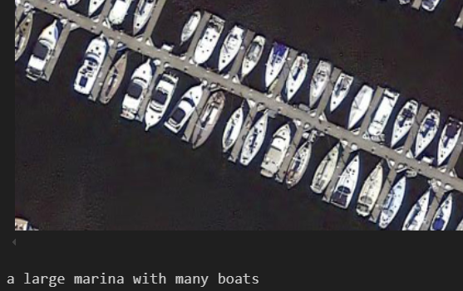
1. MMLLM ability to describe and identify objects in a scene
Prompt: “A photo of”

Slide 10
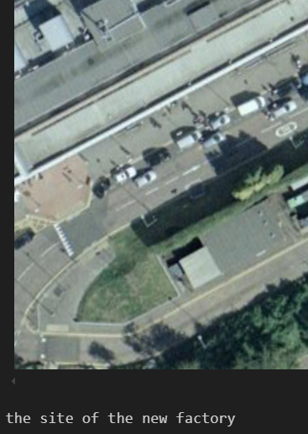
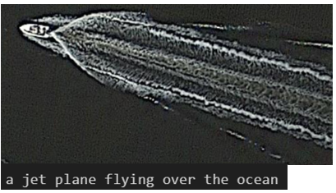
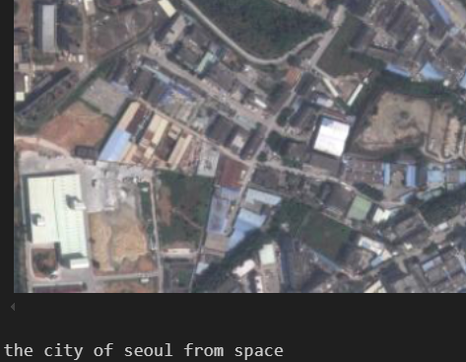
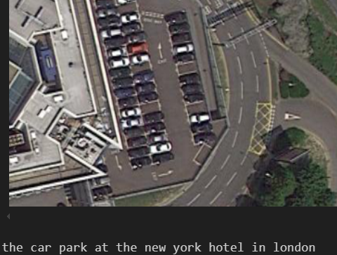
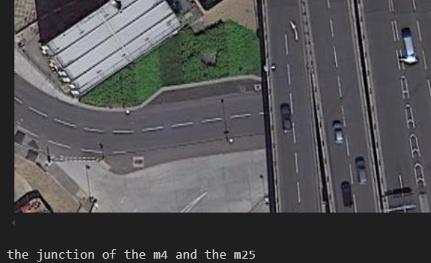
1. MMLLM ability to describe and identify objects in a scene
Prompt: “A photo of”
Can provide partially correct information
Can provide overly detailed false information
Seems infrequent, but need to quantify still

Slide 11
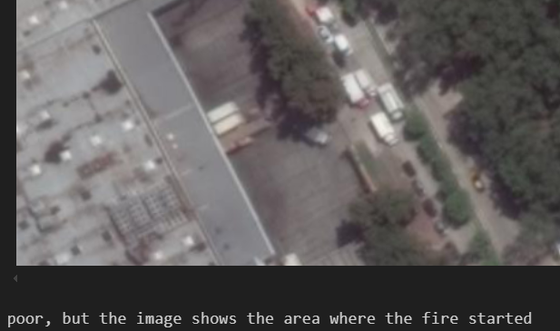
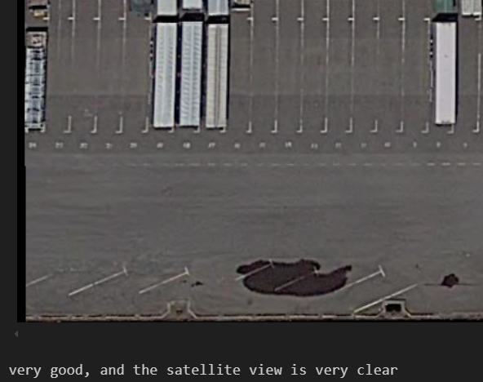
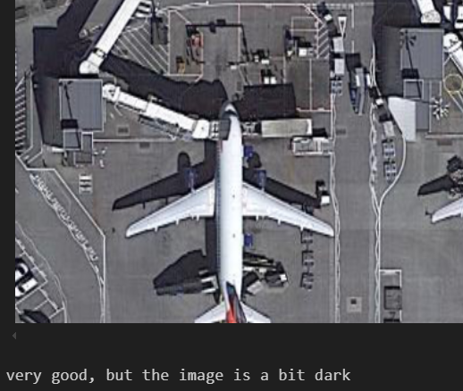
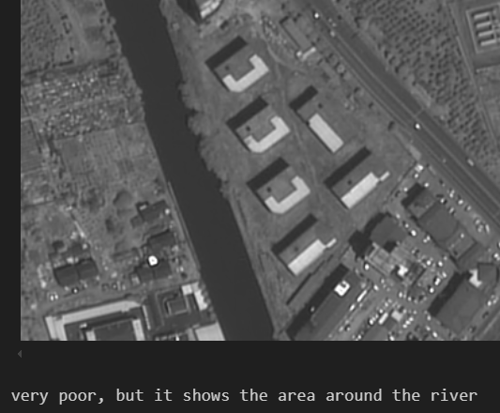
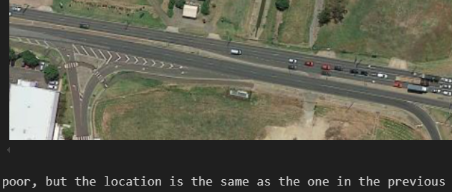
1. MMLLM ability to describe and identify objects in a scene
Prompt: “The image quality is”
Most images are poor quality
Not good for identifying image quality

Slide 12

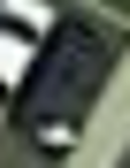


2. MMLLM ability to identify objects extracted by a conventional object detector
BLIP2 is much slower than real time object detectors
Small targets are difficult for BLIP2 to interpret correctly
Much more frequent errors
BLIP2 seems to try and give contextual information, where there is none
Annotated Object | YOLO Classification | BLIP2 Prompt Results
 | Storage-Tank | A white and black cat sitting on a bed
 | Small-vehicle | A car parked in a parking lot
 | Large-vehicle | A car with a white roof and black windows
 | Small-vehicle | A gold coin with a gold ring on it

Slide 13
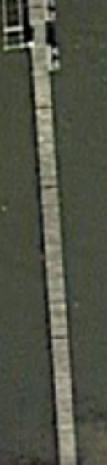
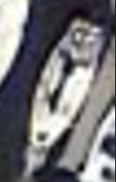

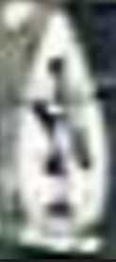
2. MMLLM ability to identify objects extracted by a conventional object detector
Annotated Object | YOLO Classification | BLIP2 Prompt Results
 | Ship | A car with a steering wheel and pedals
 | Harbor | A dock in the water with a boat on it
 | Large-vehicle | A police car parked on the side of the road
 |  | A man sitting on a bench with a sign that says “the best place

Slide 14
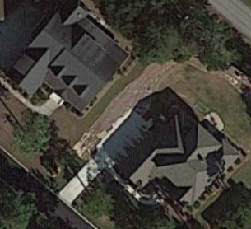

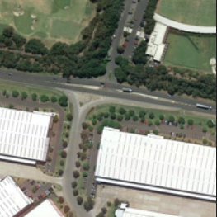
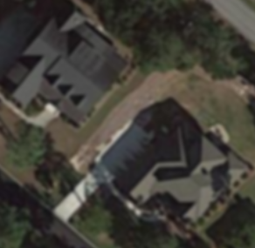
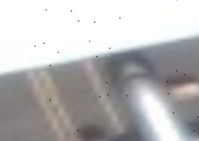
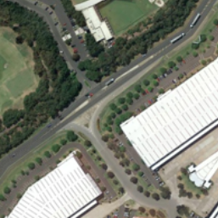
3. MMLLM susceptibility to adversarial attacks
Qualitatively robust to input noise/attacks (Blur, Drop Pixel, Rotation)
The model is affected by input noise resulting in different output prompt results
The output prompt is usually related to what is in the image after augmentation
Blur
Drop Pixels
Rotation
Original
Augmentation

Slide 15
3. MMLLM susceptibility to adversarial attacks
% word change is not a good metric as it does not account for similarity in meaning
Even large % word change is typically very similar to the original output
Prompt | Augmentation | Average % word change
A photo of | Blur | 35.04
A photo of | Rotation | 48.97
A photo of | Drop pixel | 20.7
The image quality is | Blur | 36.3
The image quality is | Rotation | 46.39
The image quality is | Drop pixel | 25.28
Augmentation | Original | New | % word change
Rotation | The site of the new building | The area where the new building will be located | 70
Rotation | A soccer field in a city | A satellite view of a soccer field | 62.5
Rotation | Four airplanes in the air | Several airplanes parked on the ground | 77.77

Slide 16
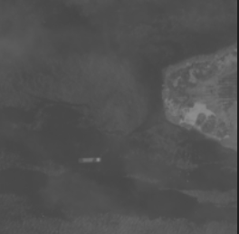
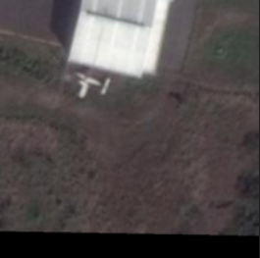
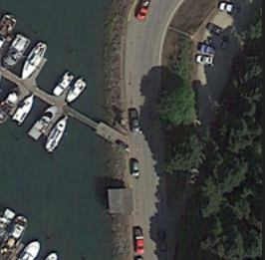
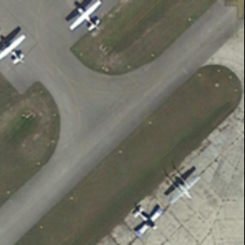
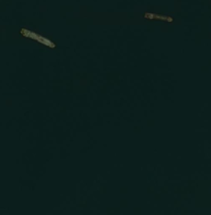
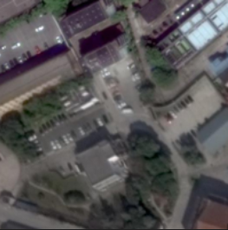
3. MMLLM susceptibility to adversarial attacks
Augmentation | Original | New | % word change
Rotation | A small island in the middle of the ocean | A ship in the water | 70
Drop pixel | a small airplane in the middle of a field | a small plane sitting on the ground | 75
Drop pixel | A marina with boats parked on the dock | A marina with boats parked on it | 33.33
Blur | A small airplane parked on the runway | The airport from above | 90
Blur | Two small boats in the water | A plane flying over the ocean | 91.66
Blur | A google earth satellite view of a parking lot | A satellite view of a parking lot | 25

Slide 17
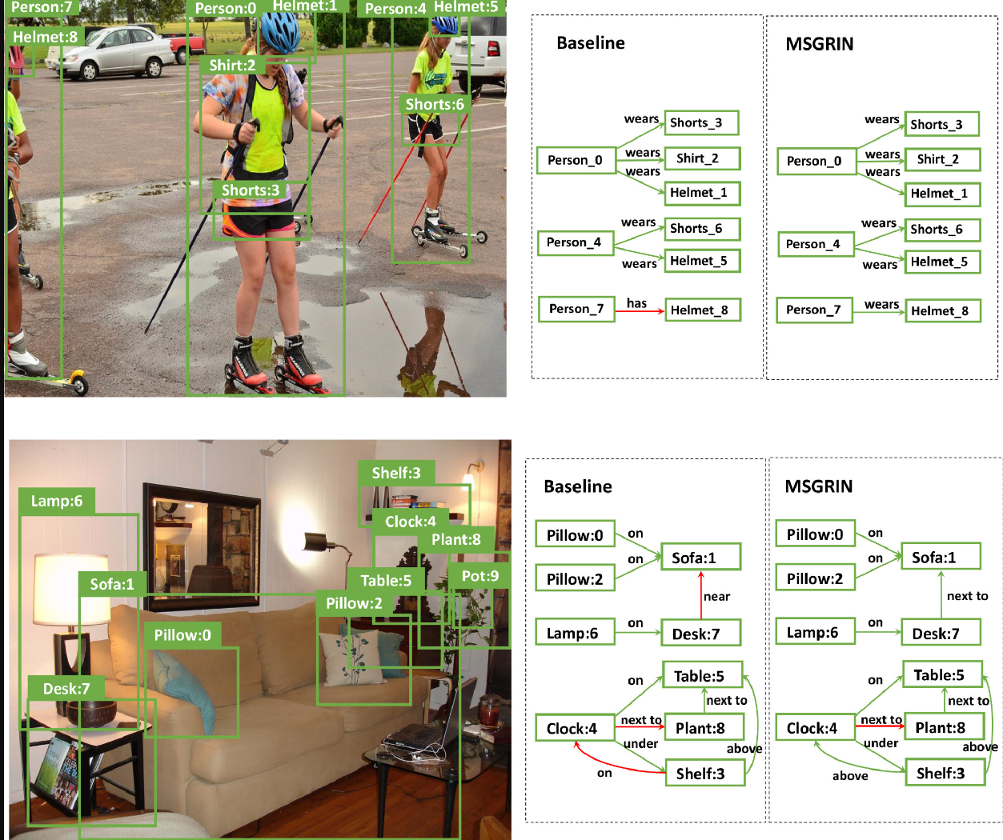
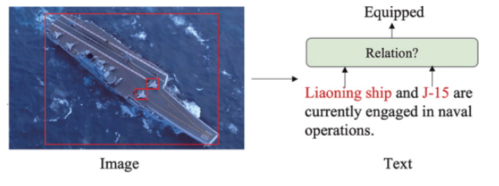
6. MMLLM ability to provide contextual information
Knowledge graphs can be another output of MMLLMs
Knowledge graphs / Semantic Networks as another mode to create context and scene explainability

Slide 18
6. MMLLM ability to provide contextual information
BLIP2 seems to be able to extract class relevant context that may be useful in a knowledge graph
Prompt used | Target Class | Top 6 words in responses (based on word frequency)
A picture of | Large-Vehicle | Parked, parking lot, trucks, airport, building, cars
A picture of | Ship | Water, boats, dock, marina, docked, house
A picture of | Harbor | Water, dock, boats, marina, house, docked
A picture of | Soccer-ball field | Field, soccer, tennis, court, satellite, city
Prompt used | Target Class | Top 6 words in responses (based on word frequency)
The image quality is | All | Poor, visible, clear, good, visible, aerial

Slide 19
Resources
https://huggingface.co/Salesforce/blip-image-captioning-large
https://arxiv.org/pdf/2303.17249
https://arxiv.org/abs/2301.12597
https://jair-neto.medium.com/a-powerful-method-for-explainability-of-object-detection-algorithms-ace0fe4623e7
https://medium.com/@tenyks_blogger/multimodal-large-language-models-mllms-transforming-computer-vision-76d3c5dd267f
https://www.mdpi.com/2076-3417/14/17/7643
https://www.atlantis-press.com/proceedings/coinfo-23/126002386
https://www.sciencedirect.com/science/article/pii/S0952197624011989
https://www.sciencedirect.com/science/article/pii/S1568494624008378
chrome-extension://efaidnbmnnnibpcajpcglclefindmkaj/https://pure.tue.nl/ws/portalfiles/portal/333614754/Parkan_A.pdf
chrome-extension://efaidnbmnnnibpcajpcglclefindmkaj/https://arxiv.org/pdf/2407.04619
chrome-extension://efaidnbmnnnibpcajpcglclefindmkaj/https://arxiv.org/pdf/2305.18279
chrome-extension://efaidnbmnnnibpcajpcglclefindmkaj/https://arxiv.org/pdf/2402.05391
https://arxiv.org/abs/2202.05786
https://arxiv.org/html/2406.02030v1
https://www.sciencedirect.com/science/article/pii/S0031320322003296

